Slide 1

Checklists and LLM Prompts
for efficient and effective test creation in data analysis
John Shiu
Orix Au Yeung
Tony Shum
Yingzi Jin

Slide 2


Slide 3
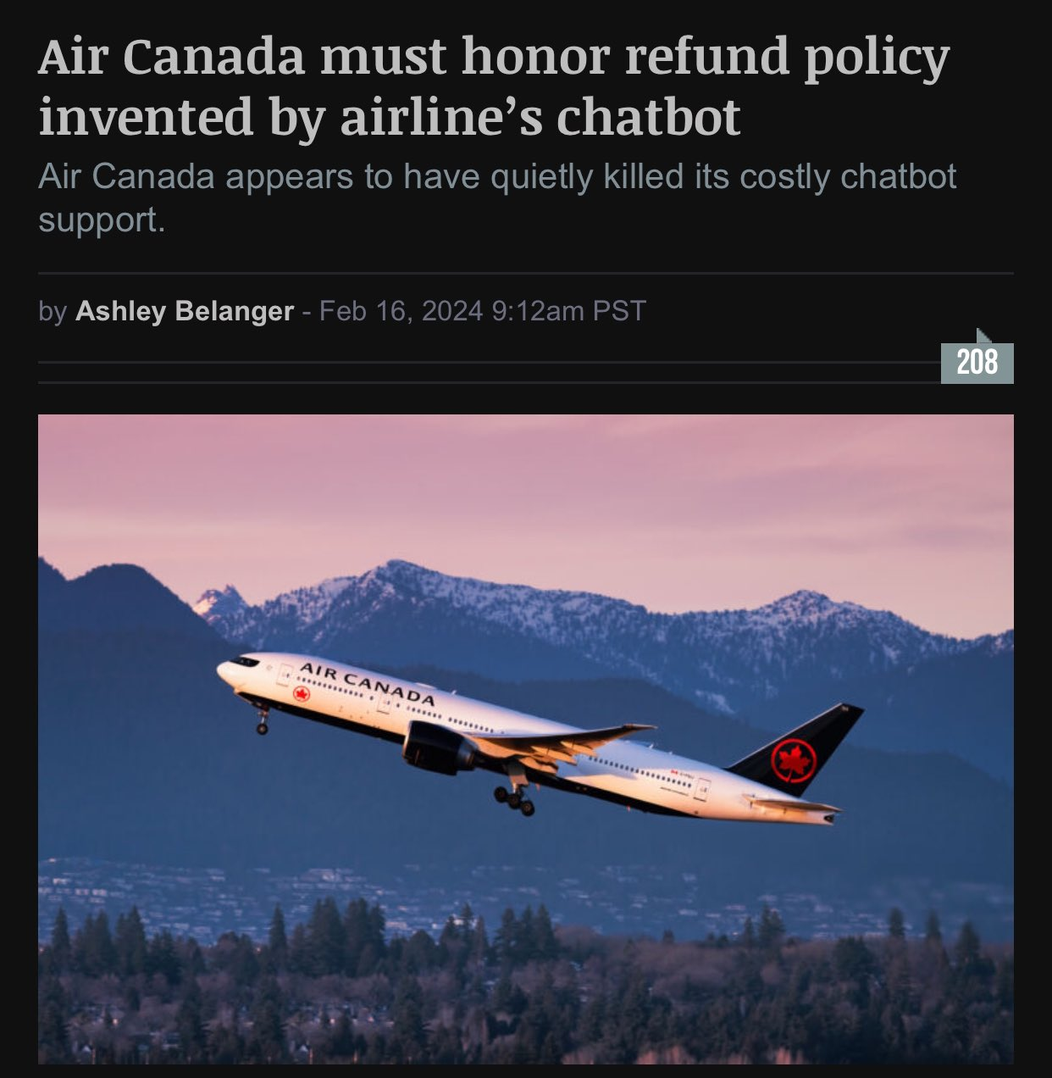

Slide 4
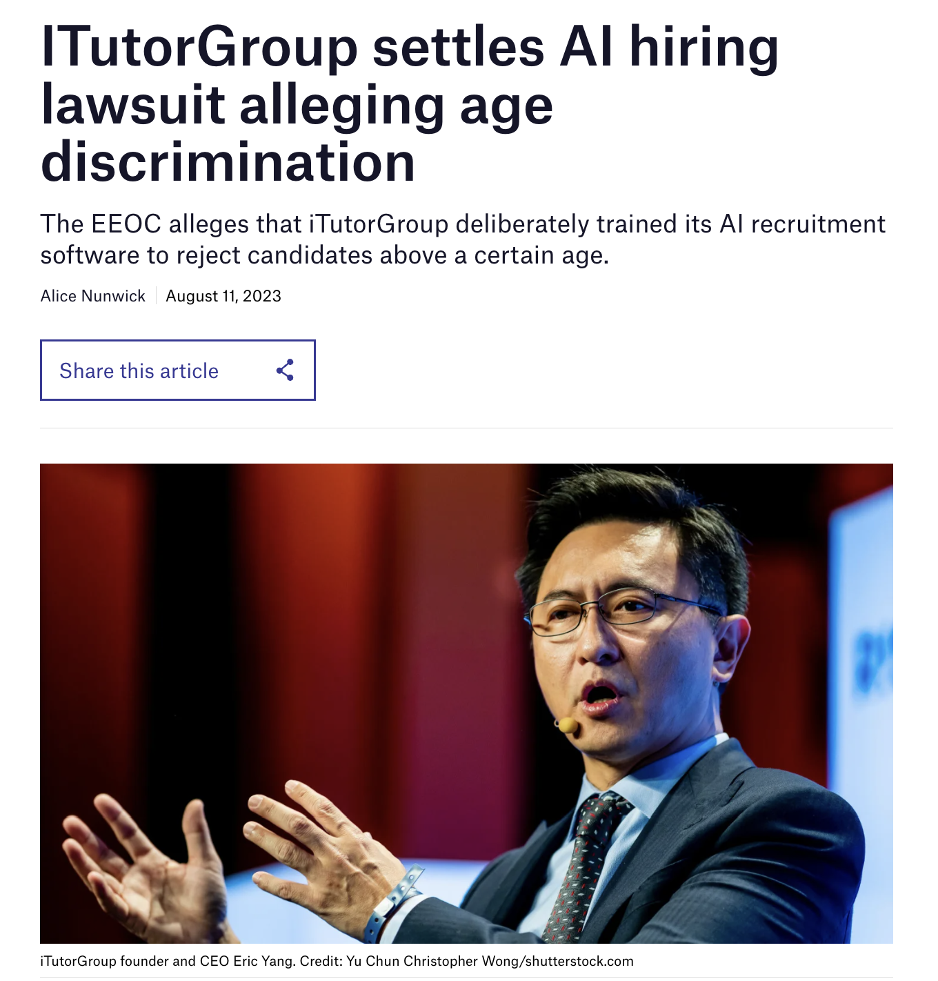

Slide 5
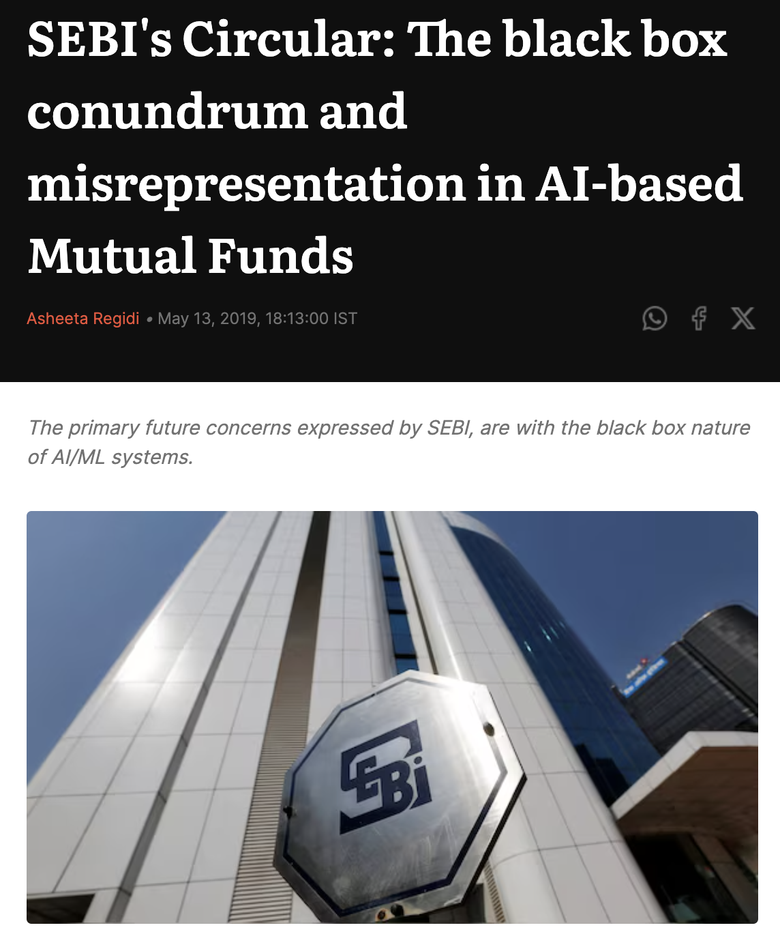

Slide 6



Slide 7

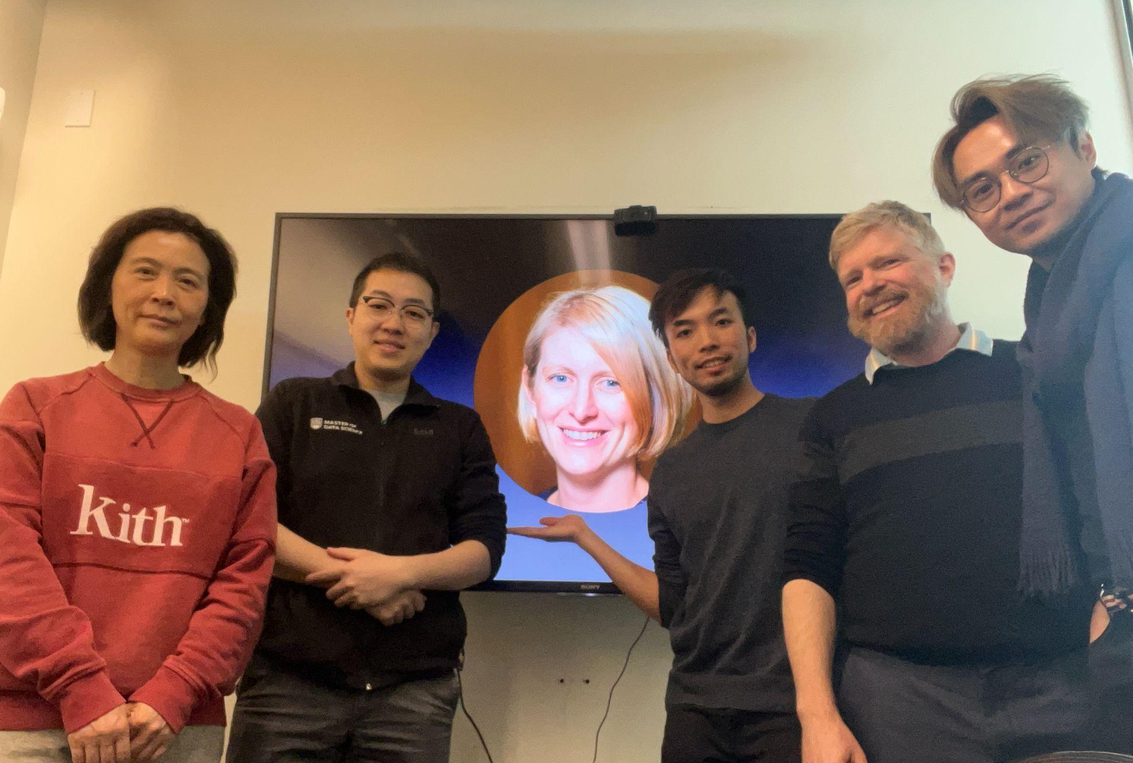
FixML GPT
John
Yingzi
Orix
Tony
Simon
Dr. Tiffany Timbers
MDS Vancouver Co-Director & Associate Professor of Teaching
Notes:
(animation included)

Slide 8
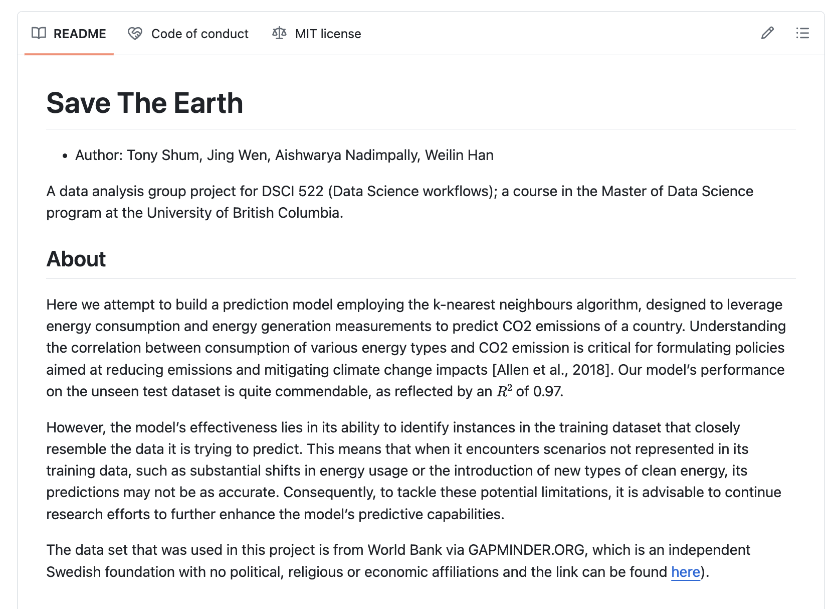
DSCI 522 Report!
110% Good job!
Best report ever!

Slide 9
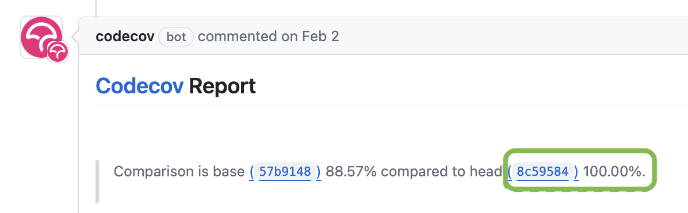

Slide 10
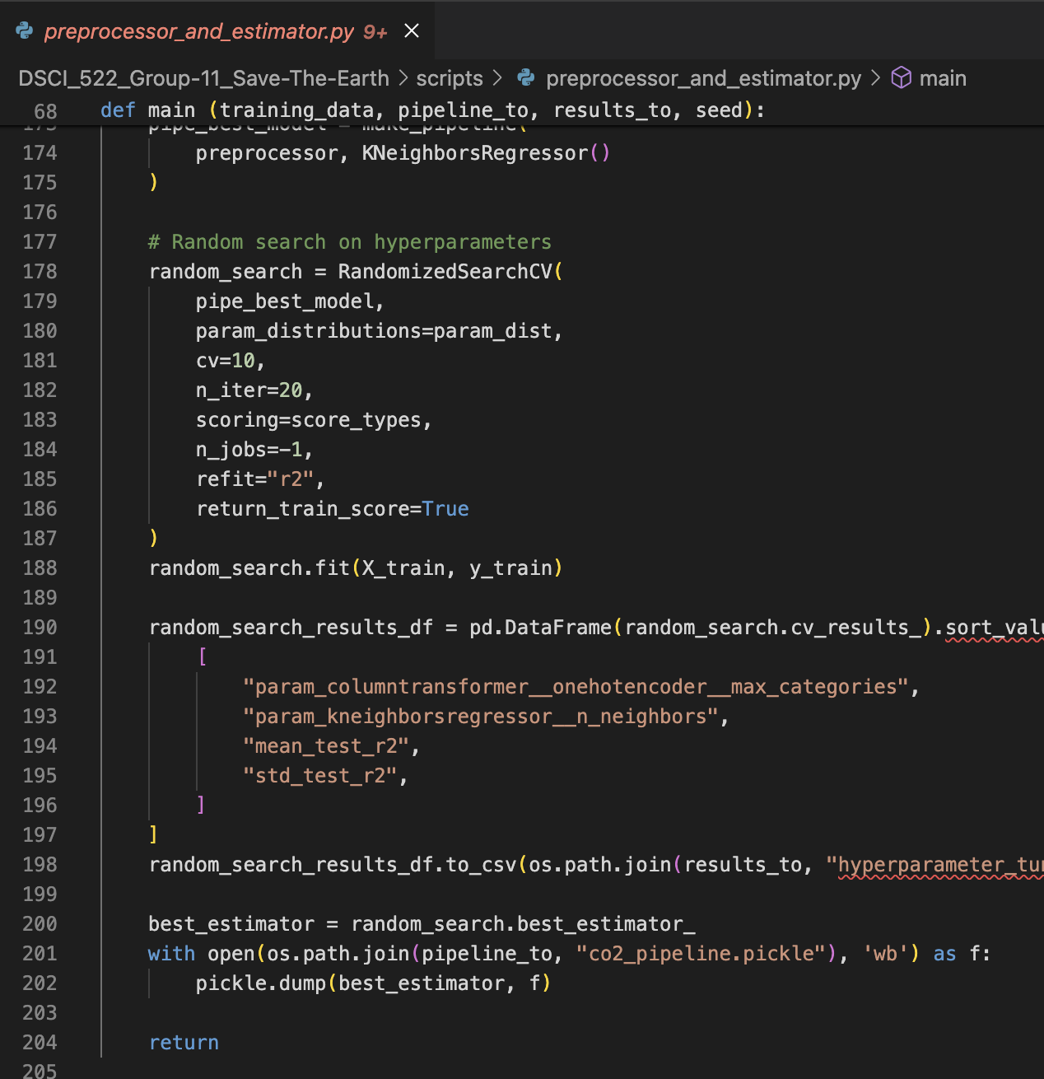
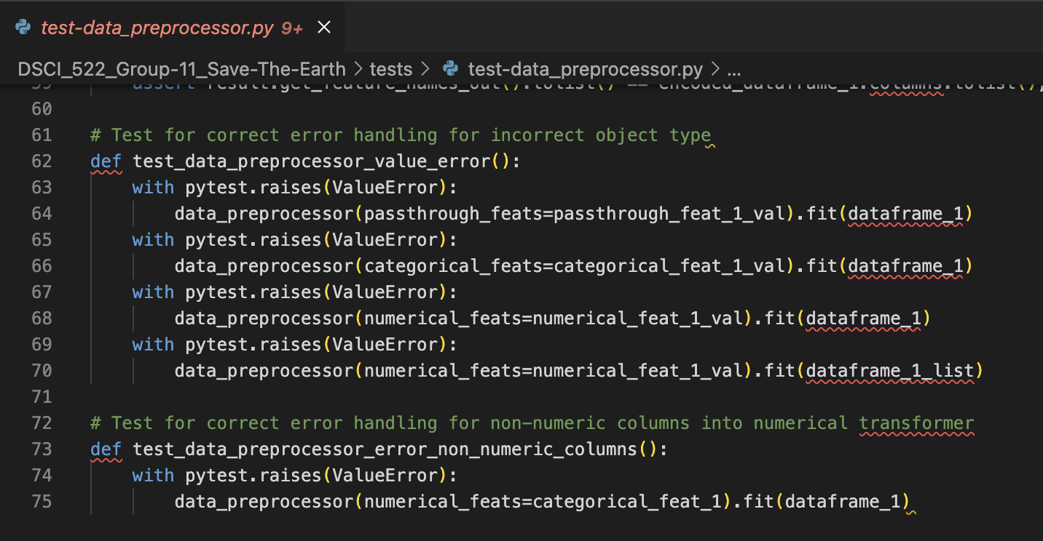
Function
Test
?

Slide 11
Function
Test

Slide 12

Function
Test
?

Slide 13



Test Complete-
ness Score
Missing Test Recommendation
Test Function
Specification

Slide 14



Input Testing
Data Ingestion
Data Preprocessing
Unit Testing
Model Testing
Codebase
Training Loop
Unit Tests
Integration Testing
78%
Covered Items
Curated
Checklist
Prompt
Template
LLM
Logo courtesy of OpenAI.

Slide 15
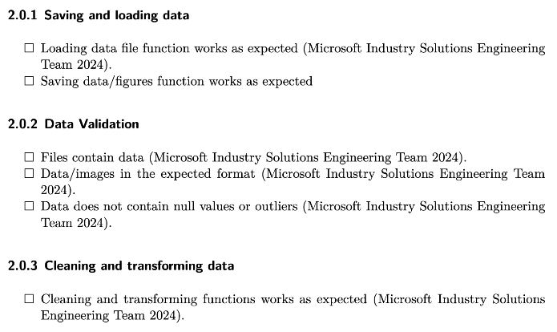

Curated
Checklist

Slide 16
Data Ingestion
Data Preprocessing
Codebase
Training Loop
Unit Tests

Slide 17
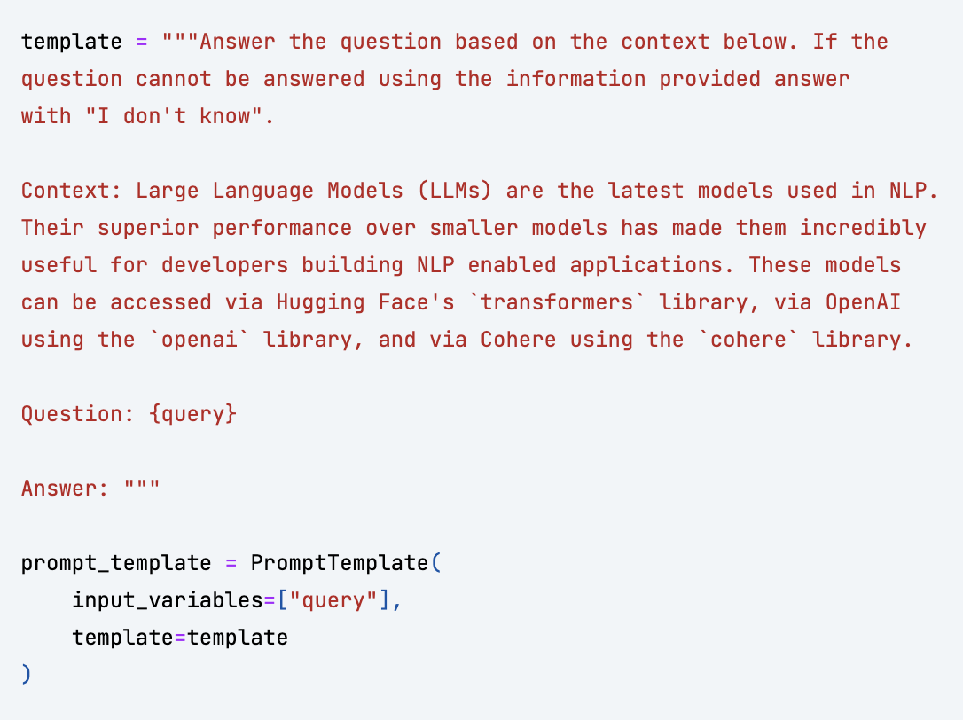
Prompt
Template

Slide 18
Input Testing
Data Ingestion
Data Preprocessing
Unit Testing
Model Testing
Codebase
Training Loop
Unit Tests
Integration Testing
78%
Covered Items
Curated
Checklist
Prompt
Template
LLM
Logo courtesy of OpenAI.

Slide 19
Week 1-2
Minimal Viable Product
Week 3-6
Iterations & Refinements
Week 7-8
Checklist & System Delivery

Slide 20
FixML GPT
Coming Soon
June 13, 2024
09:00 a.m. PDT

Slide 21
Credits
Partner
Mentor
Project Team
Visuals
Dr. Tiffany Timbers, UBC
Dr. Simon Goring, UW–Madison
John Shiu
Orix Au Yeung
Tony Shum
Yingzi Jin
Font Awesome
OpenAI

